Slide 1
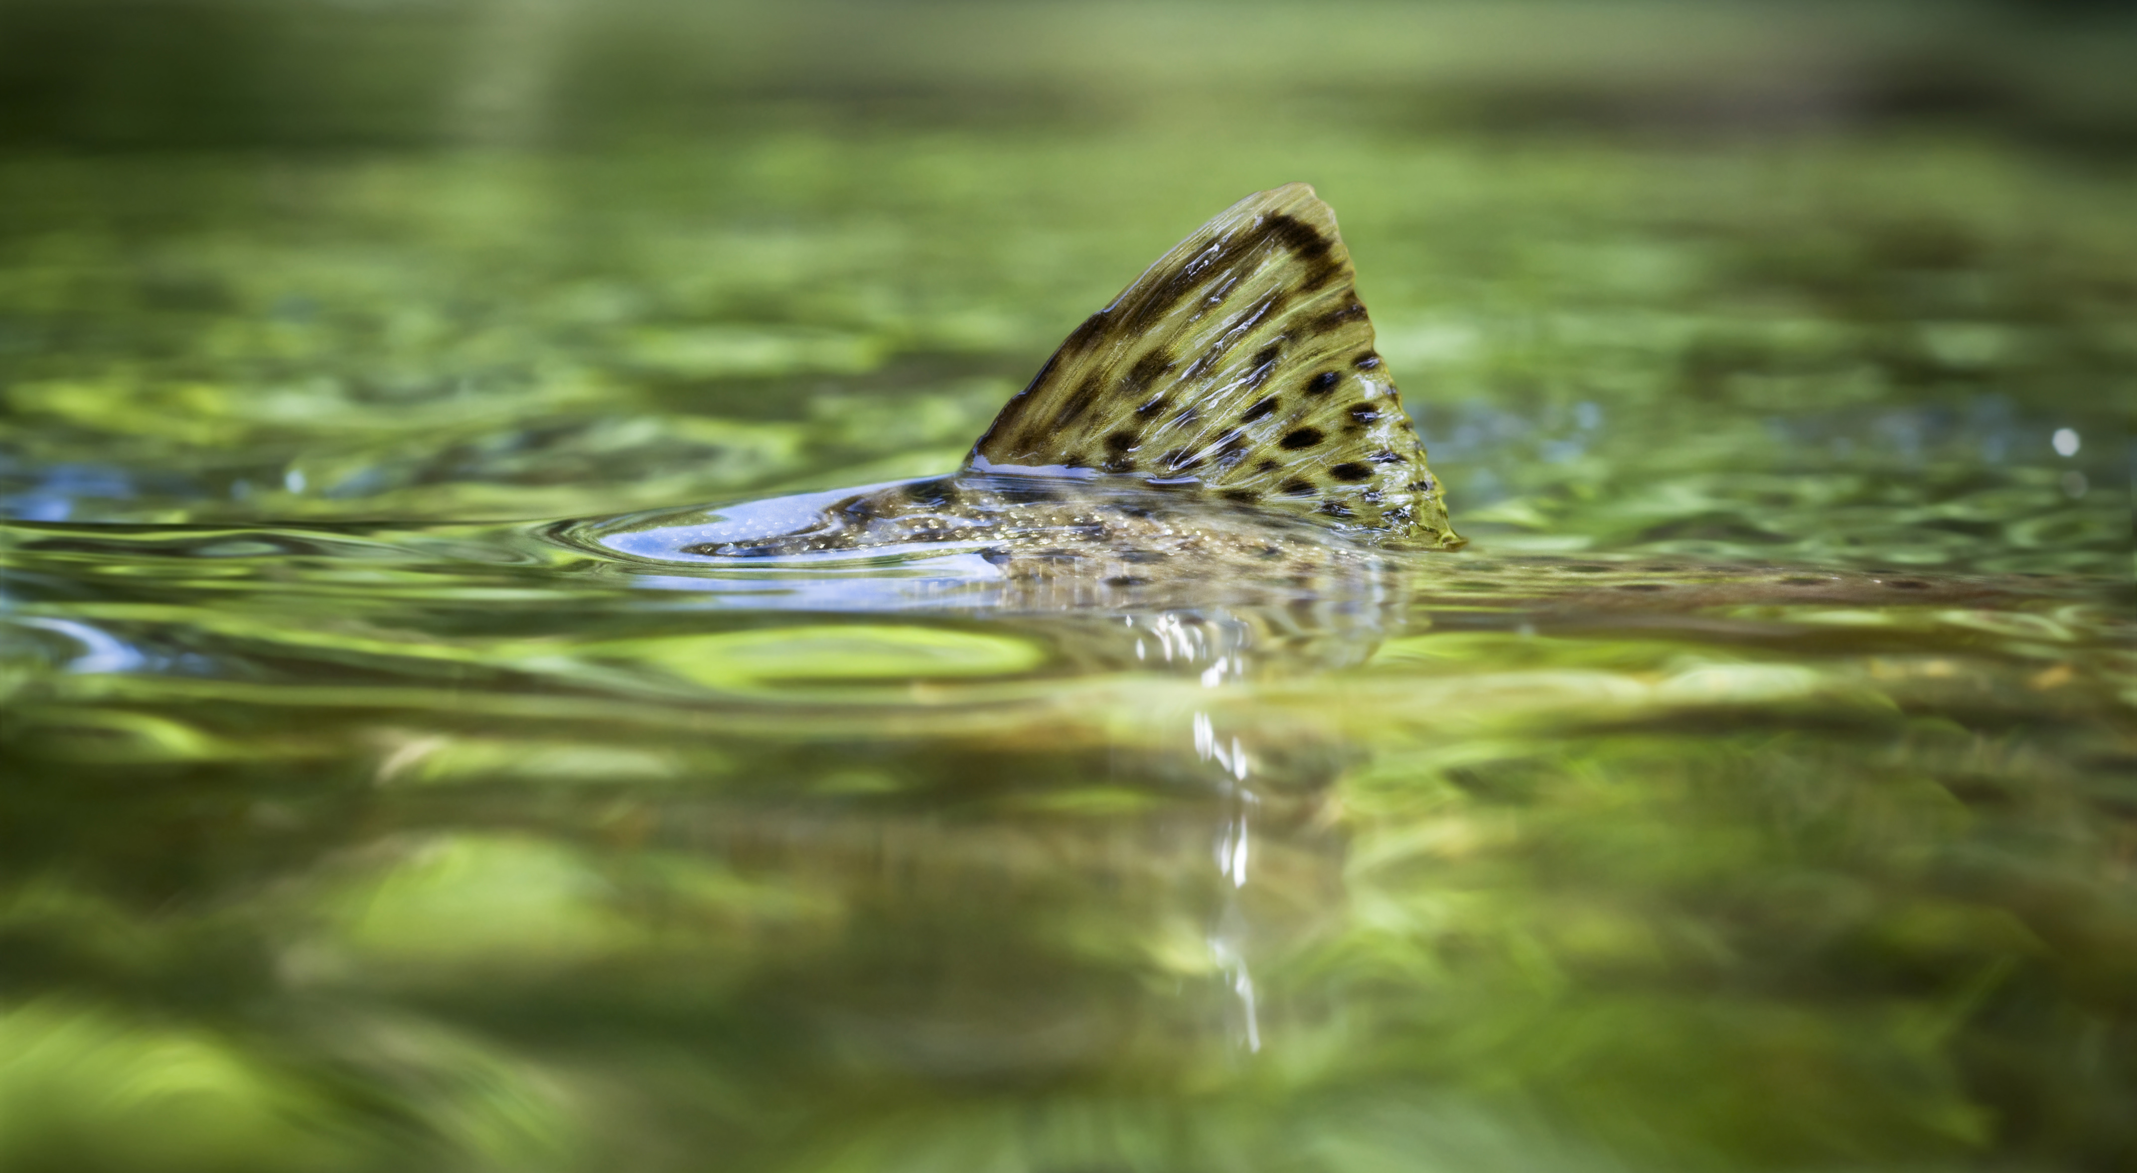
Title option (choose one and delete the other title pages; or choose your own content relevant picture)
TROUT UNLIMITED
NATIONAL LEADERSHIP COUNCIL
Notes:
Introduction
JPC – last 4 years

Slide 2
WHAT IS TROUT UNLIMITED?
150,000 Members
379 Chapters
35 Councils
National Leadership Council – 36 Reps
Board of Trustees – 33 Trustees
National Staff – 214 Employees

Slide 3
UNDER TU’S BYLAWS:
BOT COMPOSED OF UP TO 32 TRUSTEES
TEN “GRASSROOTS” TRUSTEES (INCL. NLC CHAIR AND NLC SECY)
22 “AT LARGE” TRUSTEES
Notes:
DISCUSS TERMS AND EXTENSION OF TERMS

Slide 4
TU 101: Grassroots Structure
Board of Trustees (BOT)
5%
10%
20%
Chapter Board of Directors
National Leadership Council (NLC)
Steady Volunteers
Councils
Chapters
One-time Volunteers
Membership
Members
… and how it all works together.

Slide 5
The NLC is the volunteer body that sets the direction of TU and is made up of one representative elected from each state council. The NLC has three purposes: - Establish the National Conservation Agenda - Facilitate implementation of the National Conservation Agenda - Build the organizational capacity of TU The NLC accomplishes these three tasks by being a conduit between councils and TU national. NLC Reps also serve on workgroups that focus on specific conservation or organizational issues that span more than two states.
The National Leadership Council (NLC) (Learn more at www.tu.org/nlc)
Notes:
The National Leadership Council (NLC) The role of the National Leadership Council (NLC) and its rules for functioning are detailed in Article IV. of the TU bylaws. The NLC is the volunteer body that sets the direction of TU and is made up of one representative elected from each state council. The NLC has three purposes: Establish the National Conservation Agenda (NCA) Facilitate implementation of the National Conservation Agenda (NCA) Build the organizational capacity of TU The NLC accomplishes these three tasks by being a conduit between councils and TU national. NLC Representatives bring issues and concerns from their states to the national level and then bring decisions and initiatives from the national level back to their councils. The NLC meets annually in person at the Annual Meeting and via teleconferences throughout the year. NLC Representatives also serve on workgroups that focus on specific conservation or organizational issues that span more than two states. NLC workgroups are established to address regional or organization-wide issues. These workgroups are composed mainly, but not exclusively, of NLC members and are supported by one or more staff members. There are two main categories of workgroups: conservation and organizational. Conservation Workgroups Organizational Workgroups Great Lakes Women in TU Native Trout (Western) New Initiatives Brook Trout (Eastern Brook Trout Joint Venture) Grassroots Delaware River Bylaws TU DARE (Driftless Area Restoration Effort) Fundraising Energy Education Pacific Salmon Conservancy Access Climate Change The composition and tasks of workgroups will change with time. To find out more about current NLC workgroups ask your council’s NLC Representative. The purpose of the National Conservation Agenda (NCA) is to chart the course for all components of TU – national staff, councils, chapters and members – to work together on a shared enterprise to implement TU’s mission. The most recent NCA was adopted in September of 2012 and can be viewed in full online. New in 2011 was the inclusion of critical focus areas. In 2012, these were identified as: - Pebble Mine - Yellowstone National Park native fish conservation - Gas & oil development including, but not limited to, withdrawal, distribution, sand mining, and waste management. - Upper Colorado water withdrawal - Clean Water Act - State & Federal natural resource funding - Good Samaritan fix via legislation or administration - Hard rock mining issues

Slide 6
National Leadership Council
Made up of 36 NLC Representatives elected by Councils
Election process and terms set by their respective Councils
Reps can serve up to five years
NLC accomplishes its mission via workgroups

Slide 7
NLC Representative Responsibilities
Primary function is communication: with each other, with their respective Councils, with their chapters and members and with the BOT and TU Staff
Required to attend TU’s Annual Meeting and periodic NLC conference calls
Typically join one Organizational and one Conservation Workgroup

Slide 8
NLC Organizational Workgroups
Grassroots
Communications
Nominating/New Initiatives
Education
Women in TU

Slide 9
NLC Conservation Workgroups
Great Lakes
Western Native Trout
Climate Change
Delaware River
TU DARE (Driftless Area Restoration)
Responsible Energy
Conservancy
Access

Slide 10
Proposed NLC Workgroups
Tailwaters
Vacuum dredge mining (ad hoc)

Slide 11
Workgroups that might be moved to a regional focus
Delaware River
Great Lakes
TUDARE
Western Native Trout

Slide 12
To Find Out More about the NLC
Go to www.tu.org/nlc

